Slide 1
Introduction to Machine Learning
Part 1

Slide 2
Learning Objectives for This Class
Distinguish between learning and non-learning in AI
Know when to apply neural nets
Comfortable with “genetic algorithm”
Notes:
By covering the basics of various techniques, we will compare how they can be applied. We will restrict this to two major learning approaches.

Slide 3
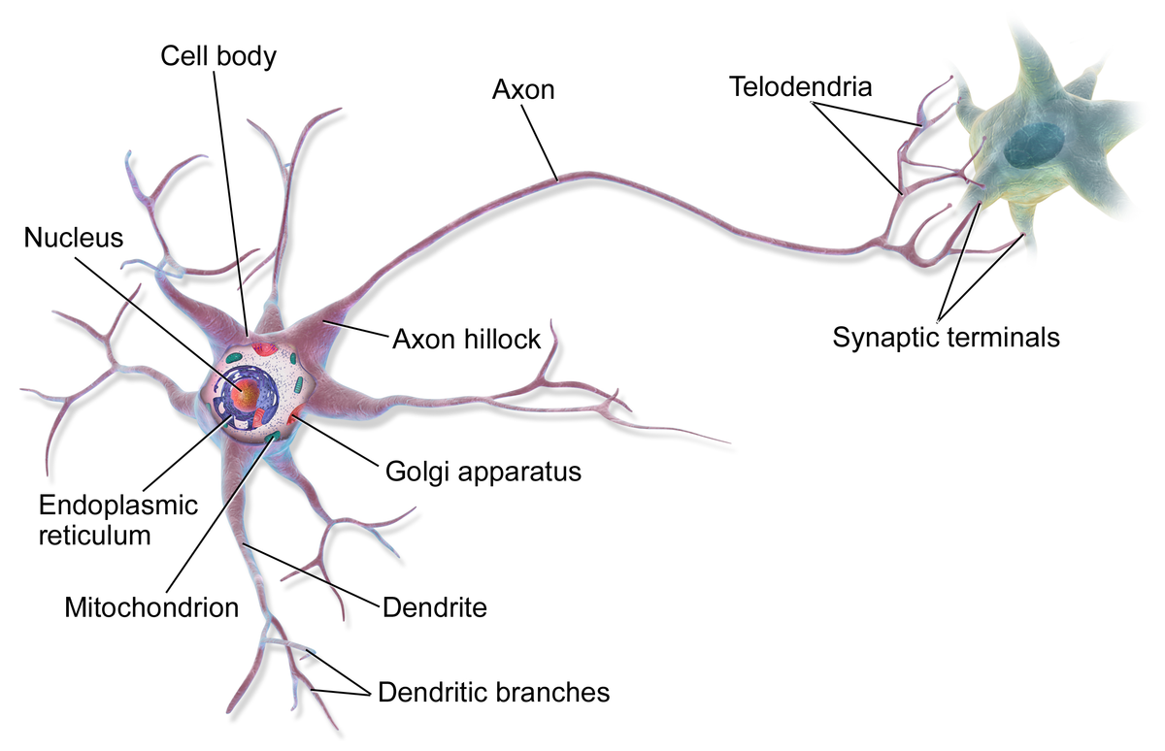
Neural Nets: What?
A problem-solving technique that simulates neurons and their interaction.
https://en.wikipedia.org/wiki/Neuron
Notes:
Neural nets are based on aspects of the brain. A Neural net consists of neurons—cells that take input from and provide output to other neurons. Importantly, a single neuron does not seem to encode knowledge as we understand it. Knowledge is encoded by the set of connections between neurons.

Slide 4
Application Examples of Neural Nets
Checking loan applications (Chase)
input: past application / success pairs
result: net usable for new applications
Recognizing handwriting (Apple)
Input: sample pairs of script / print
Credit card fraud detection
Predicting investments (Nikko; Fidelity)
Real estate appraisal
Predicting hospital stays ...
Notes:
The idea of simulating interconnected neurons has led to many applications, some of which are listed here. The rate and scale of applications has become immense—too long to list, really.

Slide 5
Examples of Neural Net Applications
System that learns to discriminate sounds
Diagnostics
Medicine
Autos
Plant repair
….

Slide 6
Neural Nets : Use when ...
Input
Model
Output
No model or expertise is known
Input/(output) examples are known
Input and output can be encoded as vectors
Notes:
We typically use neural nets when we don’t have a model of how a process actually works. But we must have a set of actual input/outputs. These are mostly from the real world. The input and output of a neural net must each be a vector—an array of numbers.

Slide 7
Neural Nets: Input
Input
Model
Output
Vector of real numbers
(or convert to this form)
Notes:
It is actually possible to represent input as an array of numbers, in many cases.

Slide 8
Neural Nets: Output
Input
Model
Output
Vector of real values,
giving answers …
consistent with performance on examples
Notes:
Once the architecture of a neural net has been decided (i.e., the interconnection pattern and the nature of each neuron’s data processing), it is fed a set of input/output pairs. These form the training set. When successfully trained, the net gives the respective output for each input to within a tolerable error. It is then ready to be tested and used on any input.

Slide 9
Neural Nets : Model
Set up processing elements (“neurons” or “nodes”) that behave like human brain neurons, with connections. Adapt the weighting on the connections to adapt the neural net to the problem.
Notes:
In many ways (even though they are modeled on brains), neural nets are “dumb.” Once we set one up, it learns from input/output data by making many numerical adjustments. We don’t model how neural nets actually work beyond that: we often can’t form much of a vision about why exactly they end up the way they do. Sometimes we get an idea of this, however.
An important skill is in how we architect (“wire” so to speak) each neural net application in the first place, i.e., prior to training it. This will be explored later in the course when we focus on neural nets.

Slide 10
Modelling Neuronal I/O
* Output =
f (wo + w’o’)
*
*
*
Process
Transfer function
input wo+w’o’
weight w
weight w’
Notes:
In software, we model each connection with a number (the weight) that reflects its relative strength.
Each neuron in a neural net takes as input the sum of a output of other neurons, weighted by the connection strength. It then applies a function (a transfer function) to this quantity. The output of this function becomes an input to other neurons (after weighting), or else it is the output to the whole neural net.

Slide 11
Modelling Neuronal I/O
Process
Process
Process
*
*
*
Process
Neuron simulation
input wo+w’o’
weight w
weight w’
output o
output o’
Process
Process
Notes:
This figure shows how a (simulated) neuron interacts with other neurons.
As with (what we know about) biological neural networks, learning consists mainly of modifying weights.

Slide 12
Backpropagation
Corresponding output:
2.1
- 2.2
Actual output:
-3.3
12.1
1. Assign random weights initially.
2. ….
w_{ij}
-0.2
Sample input data:
16.2
-1.34
112.3

Slide 13
Backpropagation
Corresponding output:
2.1
- 2.2
Actual output:
-3.3
12.1
1. Assign random weights initially.
2. The error (sum of square differences) is differentiated w.r.t. each weight.
3. Adjust weights.
w_{ij}
-0.2
Sample input data:
16.2
-1.34
112.3
Notes:
Consider the program that produces the error for a given input/output data pair. It can be considered a function of its weights and can therefore be differentiated with respect to each weight.

Slide 14
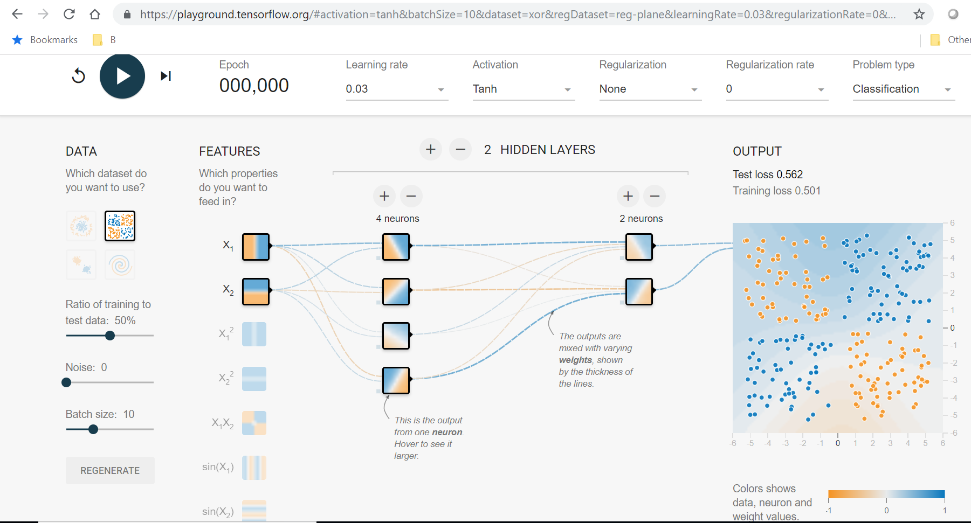
TensorFlow Playground Demo
https://playground.tensorflow.org/#activation=tanh&batchSize=10&dataset=circle&regDataset=reg-plane&learningRate=0.03&regularizationRate=0&noise=0&networkShape=4,2&seed=0.29166&showTestData=false&discretize=false&percTrainData=50&x=true&y=true&xTimesY=false&xSquared=false&ySquared=false&cosX=false&sinX=false&cosY=false&sinY=false&collectStats=false&problem=classification&initZero=false&hideText=false
Notes:
The purpose here is to show how a neural net can recognize whether a point in the unit square belongs to the blue set or the orange set. This is based on a given (“training”) set of blue and orange points. The “Playgound” allows you to try various training sets and neural net architectures.

Slide 15
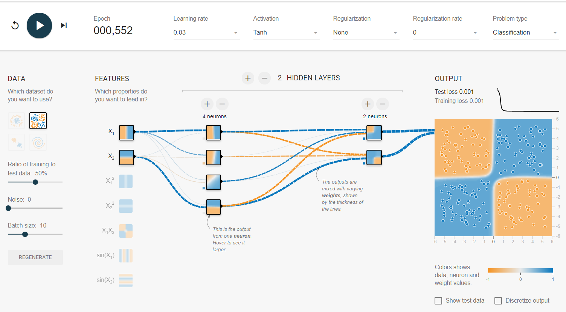
After Training

Slide 16
Deep Learning
Neural net architecture
Organized in layers
Each of higher order
Example: text summary
Sentence syntax
Sentence sense
Story sense
Notes:
A major reason that neural nets have been so successful in the second decade of the 21st century is deep learning. This is characterized by multiple layers of neurons and massive amounts of training data. These were tried for many years without much success; however, persistence, various new techniques, the availability of massive data sets, and increased computation power, which we will describe later in the course (in the neural net modules), made success possible.

Slide 17
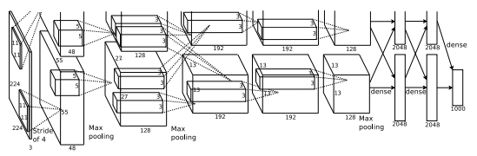
Architecture (Whole … Parts to Follow)
Notes:
What brought about the dramatic improvement, and the use of hidden layers are suggested by the figure (from the paper).

Slide 18
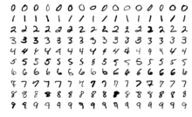
Demonstration: MNIST
https://colab.research.google.com/github/tensorflow/docs/blob/master/site/en/tutorials/quickstart/beginner.ipynb
Notes:
MNIST—from the National Institute of Stadards and Technology—is a standard example for neural nets. The input is a grid of grey-scale numbers and the output is 0, 1, …, or 9.

Slide 19
Summary of Part 1
Machine Learning: applications that learn from data / environment / behavior of agents
Neural Nets learn from voluminous data, typically input/output

